Slide 1
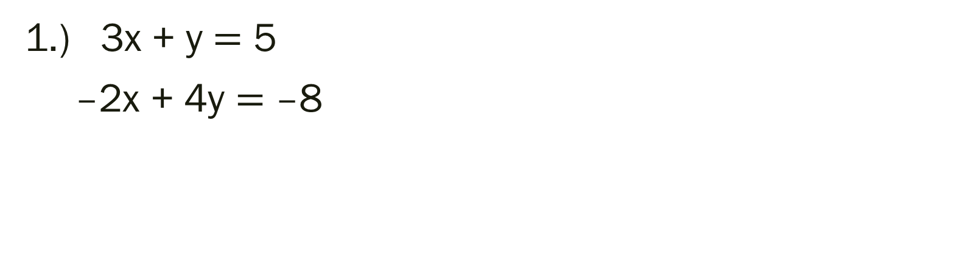
Bell Work: Solve the system.
1.) 3x + y $=$ 5
–2x + 4y $=$ –8

Slide 2
From Last Time
Page 145 #11, 15, 22, 27, 47
Page 152 #1, 3, 15
Mixed Review Page 148 #73
Page 155 #63, 65

Slide 3
ALGEBRA 3
Day 26

Slide 4
Objective: To apply knowledge of solving systems of equations to solving systems of inequalities (3.3) To solve a system using a matrix

Slide 5
Review: 3.3 Solving Systems of Inequalities
The process remains the same as yesterday with a small twist.
Just like graphing single inequalities, we must shade on either side of the line.
We are no longer looking for simply where the single point is that overlaps, but rather the entire shaded regions that overlap!
Bonus: Our calculators can do it for us again!

Slide 6
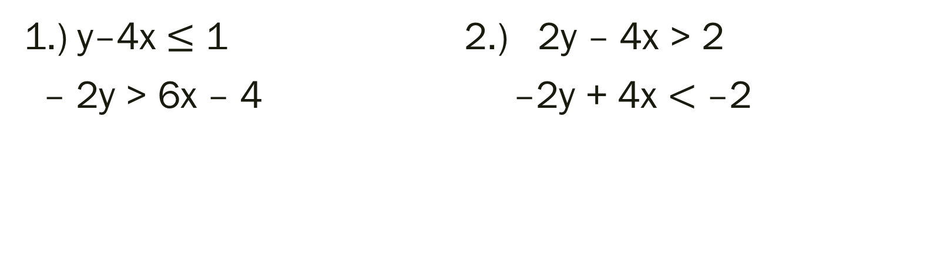
Graph to Solve the Inequality:
1.) y–4x $≤$ 1 2.) 2y – 4x > 2
– 2y > 6x – 4 –2y + 4x $<$ –2

Slide 7
3.6 Solving Systems Using Matrices
Matrix: a rectangular array of numbers
Matrix Element (entry): the numbers that make up the rows and columns of a matrix
Dimensions: rows by columns

Slide 8
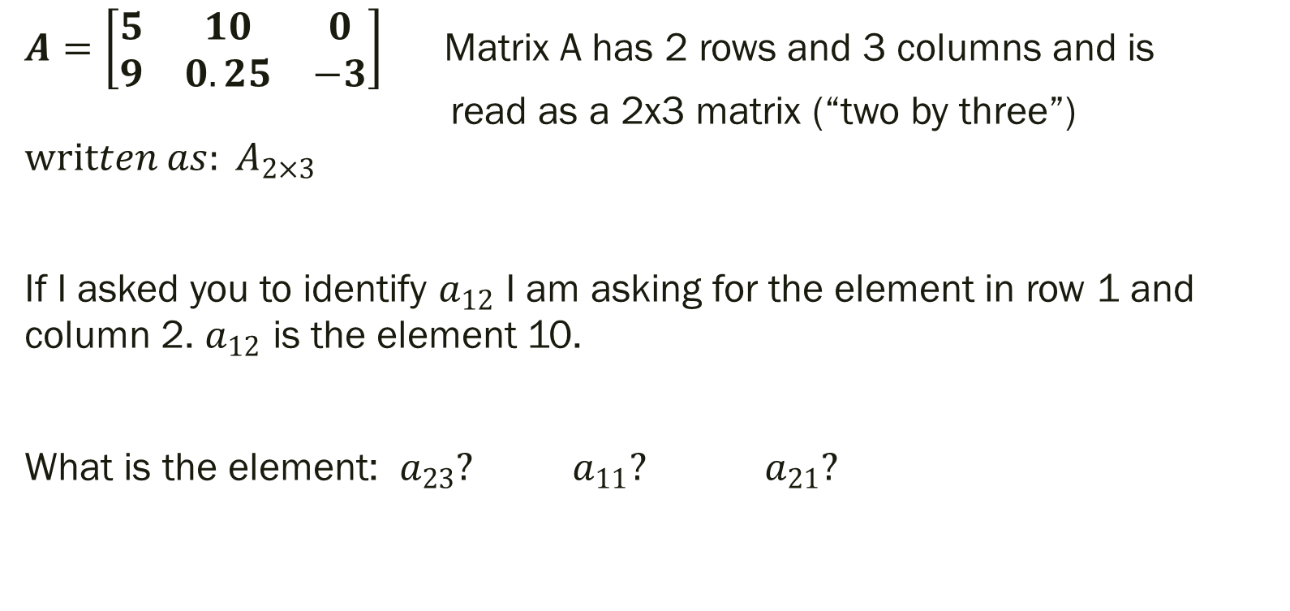
Example 1 of Identifying a Matrix Element:
$A=\left[\begin{matrix}5 & 10 & 0 \\ 9 & 0.25 & −3\end{matrix}\right]$ Matrix A has 2 rows and 3 columns and is read as a 2x3 matrix (“two by three”) $written as: A_{2×3}$
If I asked you to identify $a_{12}$ I am asking for the element in row 1 and column 2. $a_{12}$ is the element 10.
What is the element: $a_{23}?$ $a_{11}?$ $a_{21}?$

Slide 9

Using Matrices to Represent Systems of Equations
1.)
$$2x−y=4 \left[\begin{matrix}2 & −1 & 4 \\ 1 & 3 & 11\end{matrix}\right]$$ $x+3y=11$
$$x+y +2z=3$$
$2x+y+3z=7$ $\left[\begin{matrix}1 & 1 & 2 \\ 2 & 1 & 3 \\ −1 & −2 & 0\end{matrix}\right]\left[\begin{matrix}3 \\ 7 \\ 10\end{matrix}\right]$
$−x−2y =10$
2.)

Slide 10
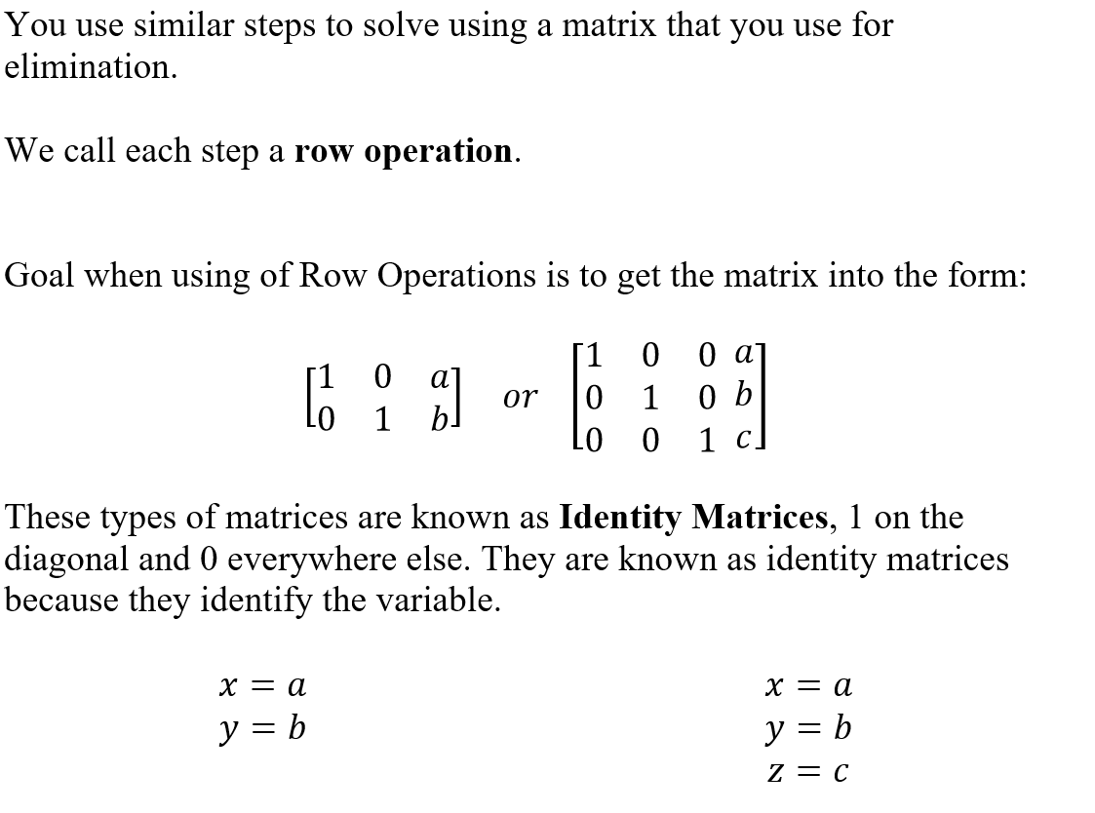
Solving a System Using a Matrix

Slide 11
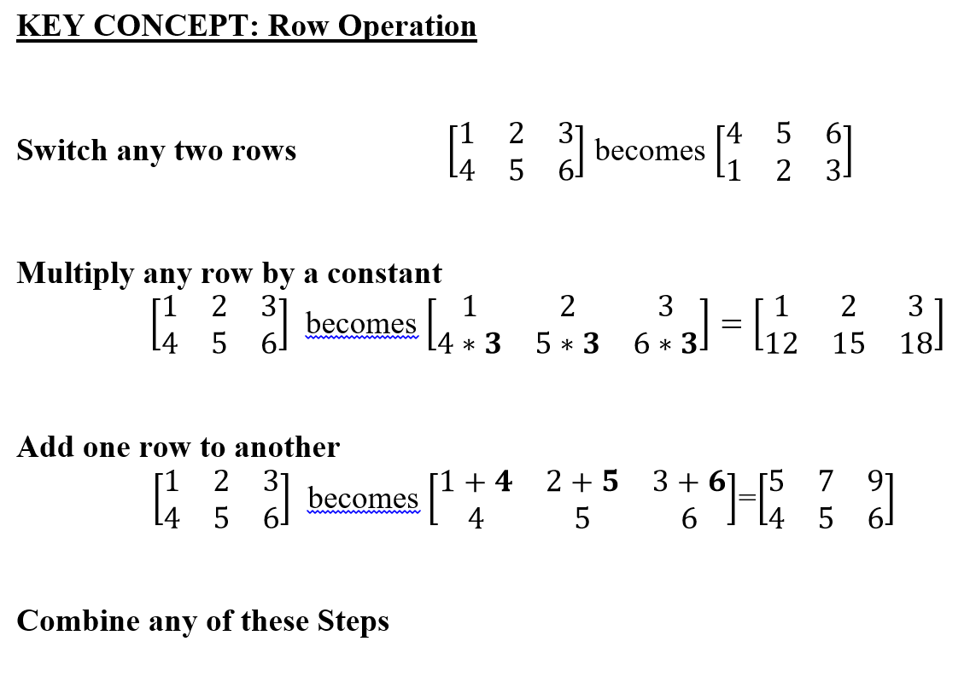

Slide 12
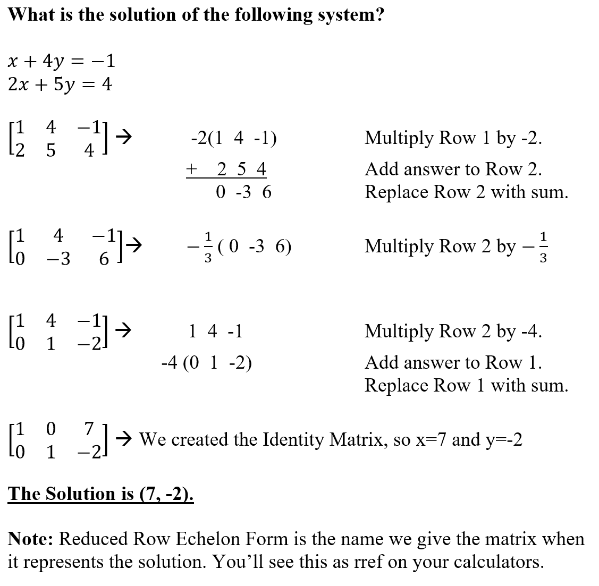

Slide 13
For Next Time
Page 179 #2, 3, 9, 11, 12, 19, 25, 27, 33
Mixed Review Page 181 #51, 54

